Slide 1
Learning Interpretable control dimensions for speech synthesis by using external data
Zack Hodari, Oliver Watts, Srikanth Ronanki, Simon King
Notes:
Good afternoon everyone! (my slot will be the first oral of the conference)
Introduce myself by name

Slide 2
What do we show
A method for creating a controllable voice, and that a human can control it
Which requires external labelled data
Users prefer the correct variation over randomly varying speech
This conclusion does not extend to latent control methods
2 / 23

Slide 3
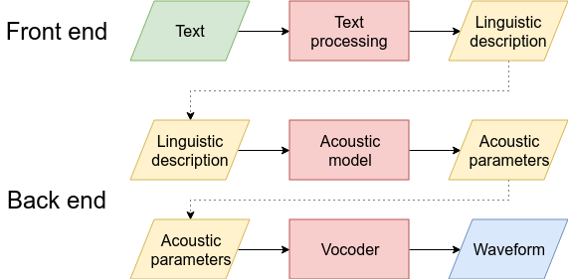
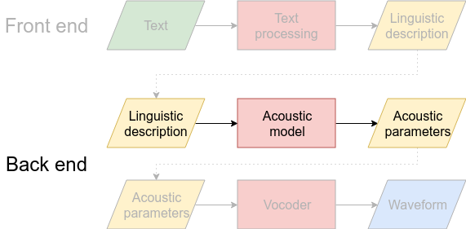
Speech Synthesis
Notes:
Produce speech according to a sequence of phones

Slide 4
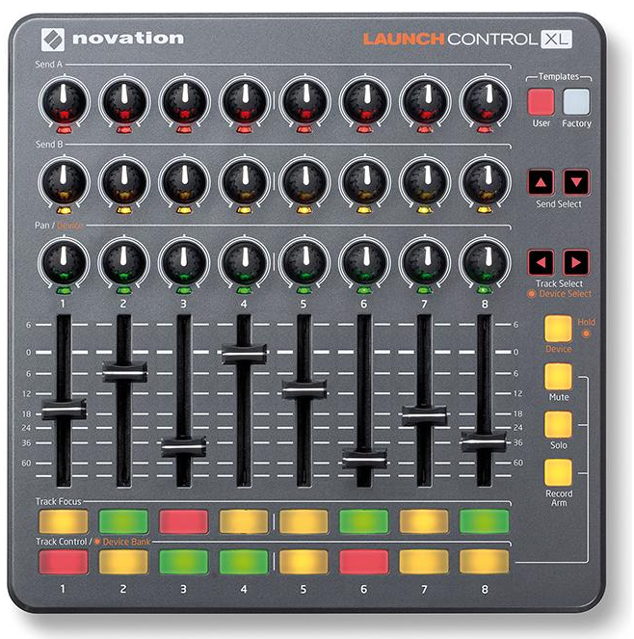
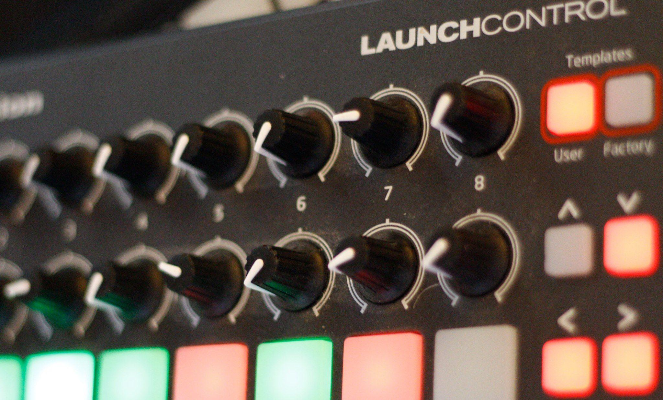
Controllability
Audiobook sentence speaking in a boring voice
Angry
Happy
Audiobook sentence speaking in an engaging style
Sad
Syllable rate
F₀
Notes:
Many use cases requiring control of variation in speech
Emotion, Prosody, Style
What if we want to customise some aspect of the speech
Need categories or sliders we can adjust
Latent method do not guarantee interpretability
For a controllable system to be usable by a human the dials should represent understandable changes.
The changes should also be predictable

Slide 5
Method
Notes:
External data allows us to encode the aspect of variation in our control mechanism
Does not solve the issue of controlling any aspect of speech, external labelled data must be available

Slide 6
Recognition from audio
Synthesis from text
Notes:
Two systems that can be used together

Slide 7
Train a labelling model
Notes:
88 utterance-level features, designed to be predictive of emotion
We model variation at the sentence level

Slide 8
Add labels to TTS data
TTS training samples:
(text, waveform)
After labelling:
(text, waveform, control values)
Notes:
We model variation at the sentence level

Slide 9
Train TTS voice using labels
control values
Notes:
We model variation at the sentence level

Slide 10
After training, can generate “oracle” style
Notes:
We use the trained classification model (softmax output) to provide labels for the TTS dataset

Slide 11
Data

Slide 12

External dataset - IEMOCAP
Interactive Emotional Dyadic Motion Capture dataset
12.5 hours
10 actors
2 hours per dyad (~30 conversations)
4.5s average utterance length
Categorical emotion labels
Example of female speaker scripted
Example of male speaker improvised
Notes:
Designed for multi-modal research
Scripted and improvised conversations

Slide 13
TTS dataset - Blizzard Usborne audiobooks
Children's audiobooks (4-6 year olds)
6.5 hours
Single female southern British English speaker
Children’s story
(red riding hood)
Shakespeare (Macbeth)
Non-fiction
(story of chocolate)
Notes:
Stories are read expressively
Not perfectly matched with IEMOCAP style

Slide 14
Train using IEMOCAP
Train using Blizzard
Notes:
We use the trained classification model (softmax output) to provide labels for the TTS dataset
Can be used in a variety of ways

Slide 15
Experiments

Slide 16
Experiments
Recognition (model used for labelling)
Synthesis
Control of perceived emotion
Variation in longer texts
Notes:
We get results competitive with state of the art for IEMOCAP

Slide 17
Experiments
Recognition (model used for labelling)
Synthesis
Control of perceived emotion
Variation in longer texts
Notes:
Using 31 students
~1 hour tests

Slide 18
Control of perceived emotion
Notes:
First listening test, forced choice classification

Slide 19
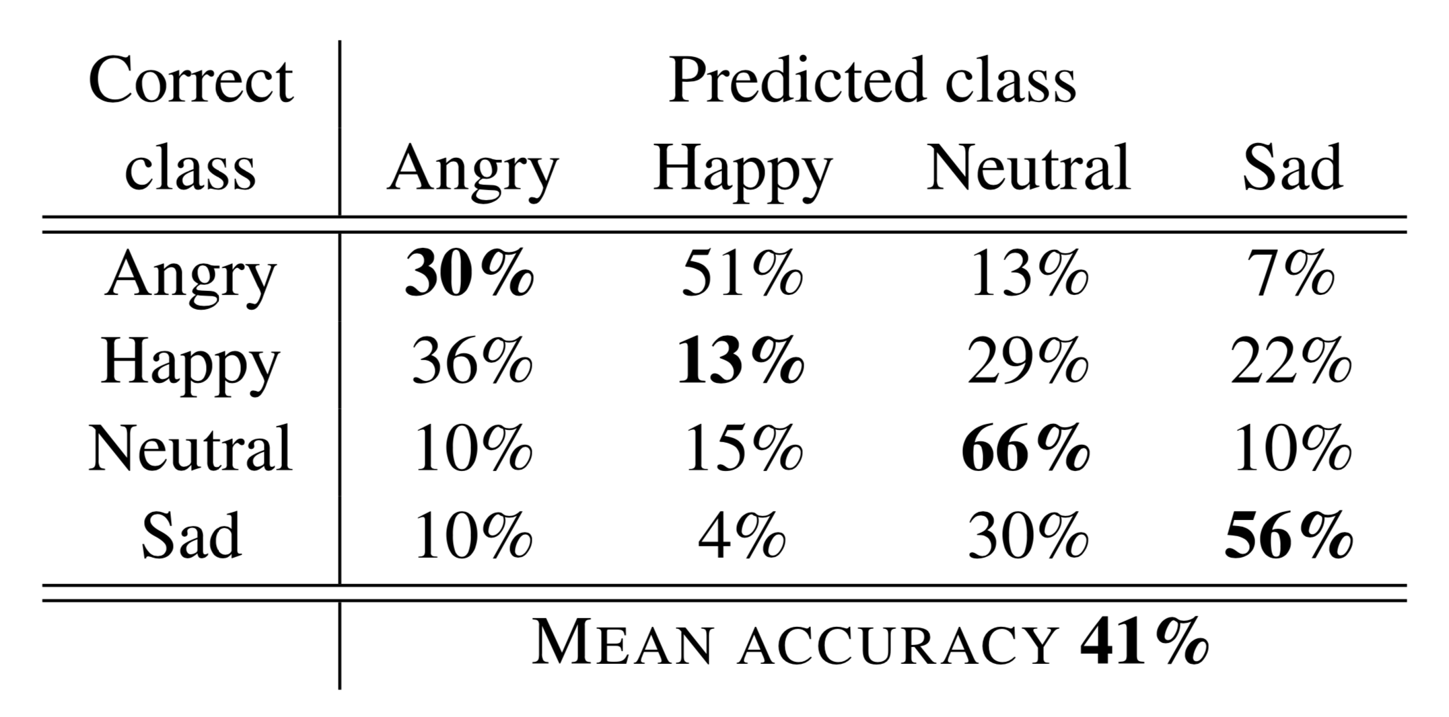
Control of perceived emotion
IEMOCAP inter-annotator agreement
48% (10 classes)
Human performance (upper bound)
~50% (Banse et al. 1996)
Human performance (5-class)
56% (Scherer et al. 1991) 64% (Bezooijen 1984)
Voice tries to sound
“Each sentence is being said with a different emotion.
Your task is to label each sentence with an emotion.”
Listeners perceived
Angry
Happy
Neutral
Sad
Emotion class
IEMOCAP inter-annotator agreement (10 classes) | 48%
Human performance (upper bound) | ~50% (Banse et al. 1996)
Human performance (5-class) | 56% (Scherer et al. 1991) 64% (Bezooijen 1984)
Notes:
Forced choice classification, labels are balanced (random baseline is 25%)
Happy is known to be harder to reliably produce
Overall performance is reasonable
It is possible that angry and happy are being modelled more as arousal
There is a chance, the listeners just blindly classifying. Might have been good to add additional false labels

Slide 20
Variation in longer texts
Notes:
Second listening test, pairwise preference
Users listen to paragraphs create by a system with a human in the loop

Slide 21
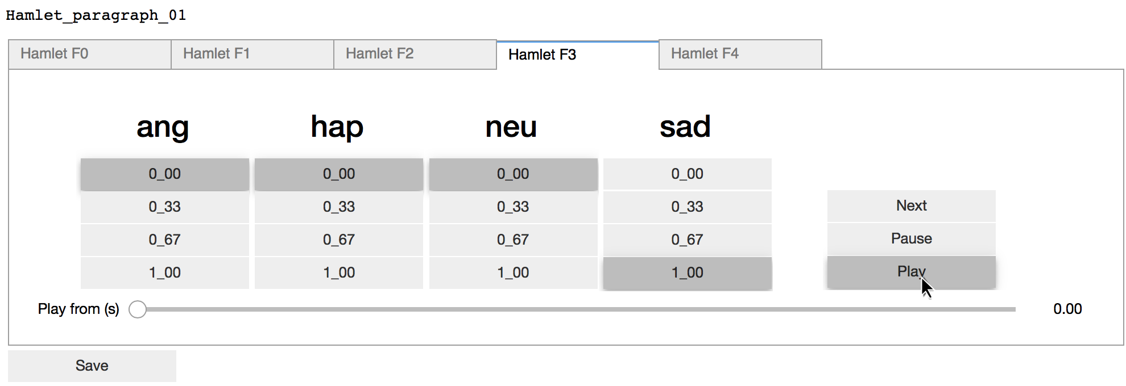
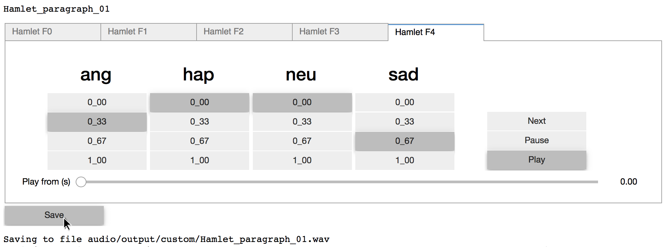
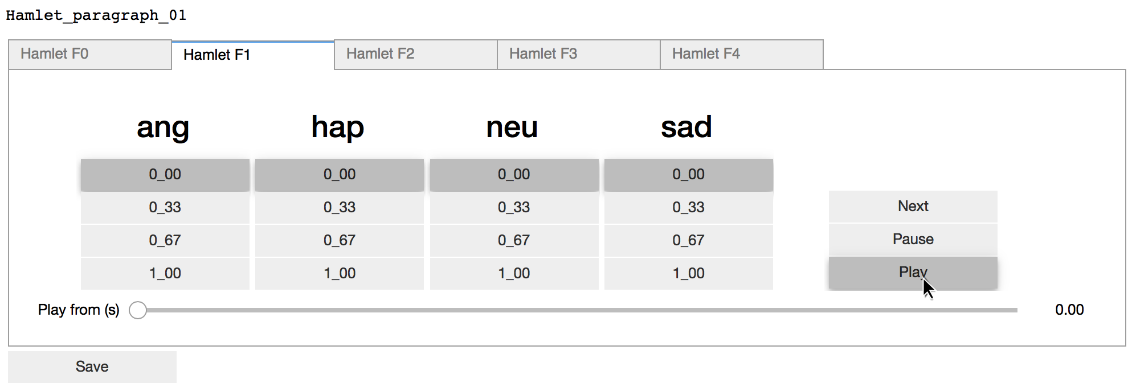
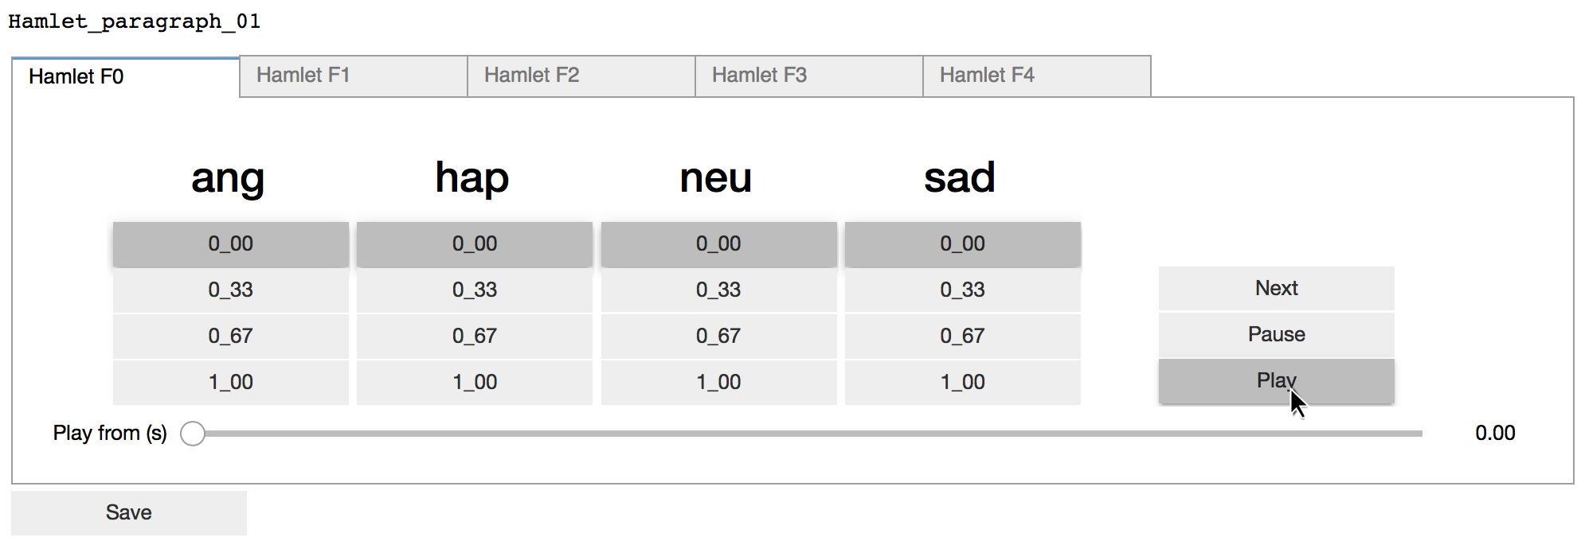
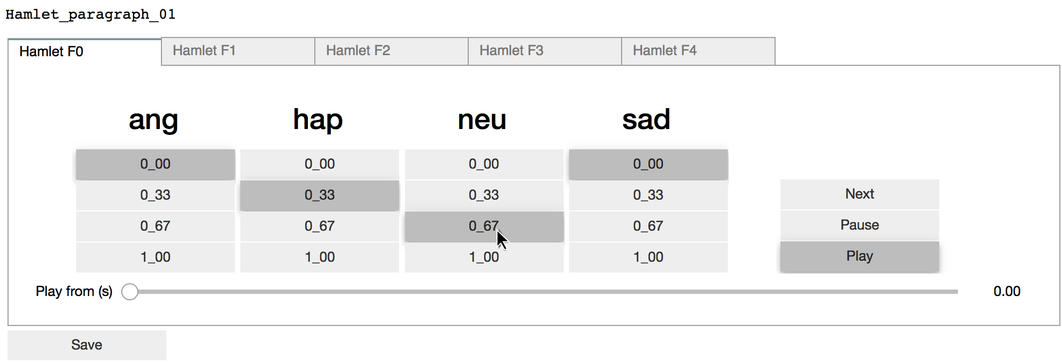
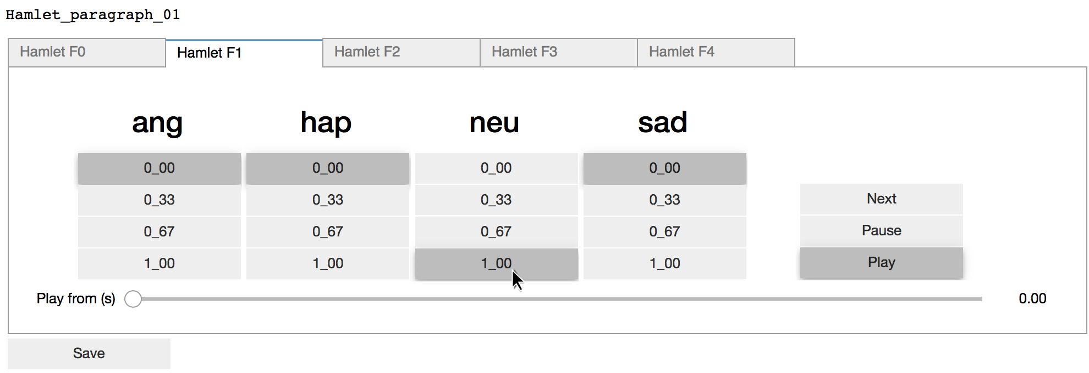
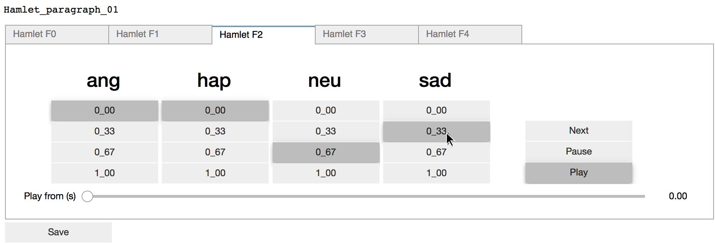
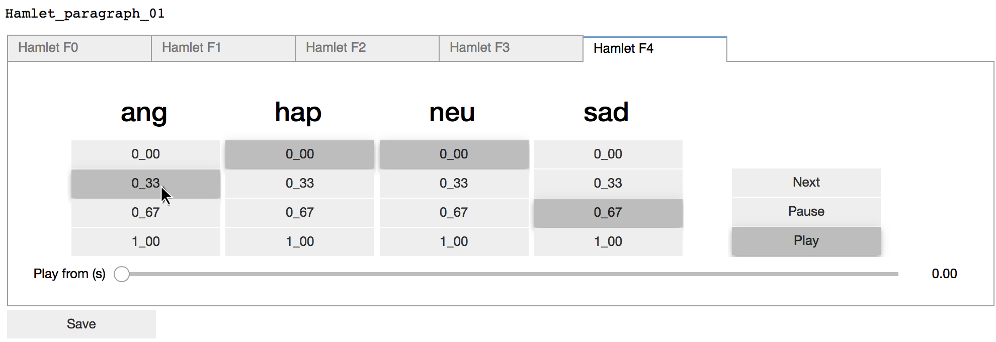
Variation in longer texts
Creation of test material by human curator
Notes:
This is the UI that I use to prepare the listening test material
Paragraphs 24s on average

Slide 22
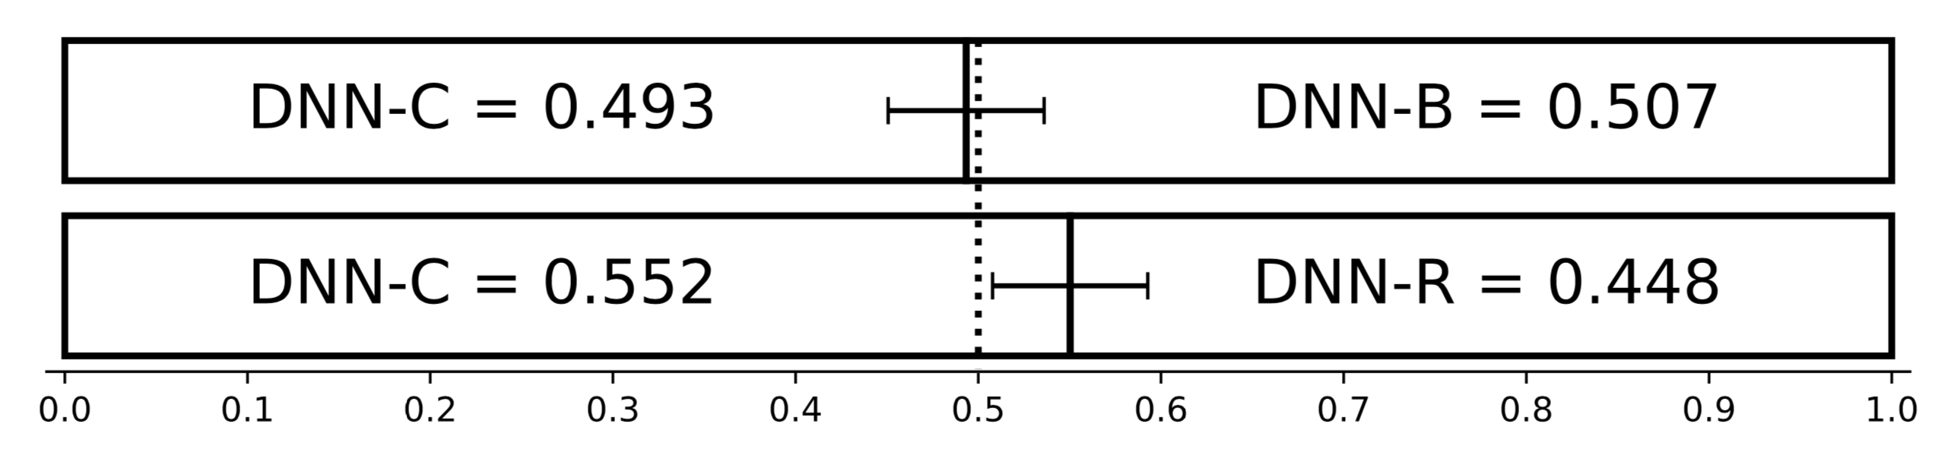
Variation in longer texts
“Choose the version you would prefer if you were listening to an audiobook for pleasure.”
Baseline
Control
Random
Notes:
Pairwise preference test
DNN-C: controlled human-in-the-loop system
DNN-D: baseline non-controlled voice
DNN-R: same as DNN-C, but with random control values
We show that users prefer appropriate variation in the case of interpretable control, the same may not apply for latent control dimensions

Slide 23
Conclusions
Demonstrated a method for providing interpretable control
This does require external labelled data
Defining the dimension of speech to be controlled is still a challenge
Relying on external data places this task with the human annotators
Notes:
Does not solve the issue of controlling any aspect of speech, external labelled data must be available

Slide 24
Questions?

Slide 25
Interpretable control using external data
Notes:
We use the trained classification model (softmax output) to provide labels for the TTS dataset
Recognition model was actually performing multi-task learning (continuous emotions)

Slide 26
Labelling task - Emotion recognition
Primary task: Happy, Sad, Angry, Neutral
62.9% (unweighted accuracy)
Current SotA: 65.7% (John Gideon et al. 2017)
Notes:
SotA: Progressive nets (ProgNet)
Secondary metric is not easily understandable, but this was not our focus
An alternative would have been to map the real valued labels into classes

Slide 27
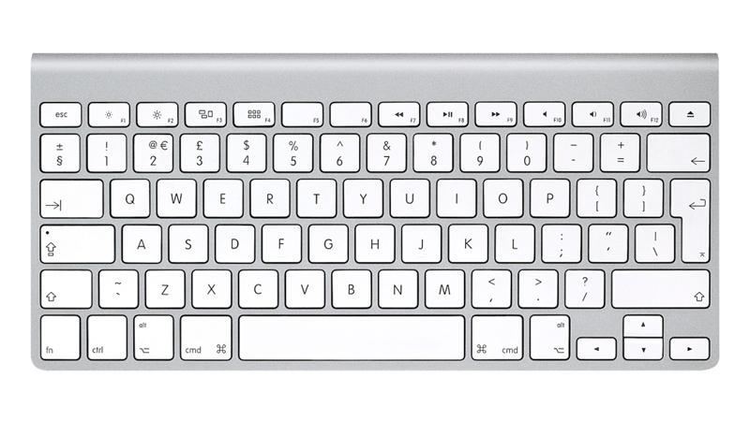

Interpretability
Notes:
Latent method do not guarantee interpretability
For a controllable system to be usable by a human the dials should represent understandable changes.
The changes should also be predictable

